Slide 1
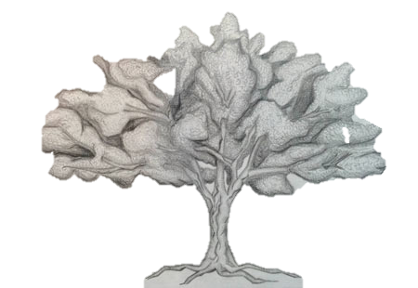
RESEARCH COMPETENCIES IN ALLIED HEALTH
Ann Russell, PhD
The Michener Institute for Education at UHN
The Research Institute for Health Care Education, UHN
Notes:
We’ve been asked to consider 4 questions:
The vision and mission for research in the college sector
How to build research capacity in the college sector
What are the essential research competencies vis a vis a changing health care landscape
And finally, how to colleges “produce agile graduates with research capabilities” to deal with accelerated change?

Slide 2
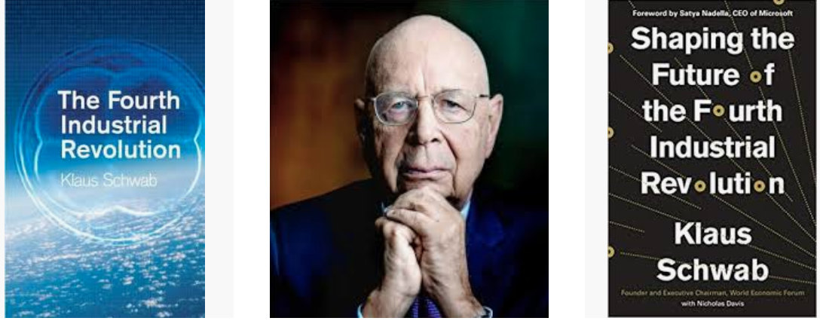
COMPENTENCIES IN THE CONTEXT OF 4IR

Slide 3

COMPETENCIES RECONSIDERED
Notes:
https://www.d2l.com/future-of-work/
The Future of Work
in the Fourth Industrial Revolution
“The exponential shift that the Fourth Industrial Revolution brings is altering almost every industry in the world. No part of society will be left untouched, including the education and workforce development sector’s role in preparing people for the future of work in this new world. Competencies include creativity, curiosity, agility, adaptability.”
https://discover.rbcroyalbank.com/humans-wanted-canadian-youth-can-thrive-age-disruption/
Humans Wanted, RBC
SOME SURPRISING STATISTICS IN THE REPORT:
-65 percent of children entering kindergarten in 2020 will end up in jobs that currently do not exist; and
-With such a rapid production of information, nearly 50 percent of the subject knowledge studied in the first year of a four-year technical degree will be outdated by the time the individual graduates.
-More than 25% of Canadian jobs will be heavily disrupted by technology in the coming decade.
Disruption Is Accelerating
Flexibility Is the Future
Digital Literacy Is Essential
We Need to Prepare for the Future of Work and current education institutions and workplaces are inadequately designed to meet the needs of preparing the future labour force.
Essential skills and competencies identified in the RBC report include:
Critical thinking, co-ordination, social perceptiveness, active listening and complex problem solving are essential.
Digital fluency and literacy will be essential to all new jobs.
Global competencies like cultural awareness, language, and adaptability will be in demand.
All jobs will require judgment and decision making and more than two thirds will value an ability to manage people and resources

Slide 4
ESSENTIAL COMPETENCIES
Adapted from “Essential Competencies: Scientific, Information, and Data Literacies” by Maria Romano (2019)
DATA LITERACY
Statistical comprehension
Interpretation of raw/primary data
Data collection
Data management
Implications of data in a broad context
Information Knowledge
Overlap between competencies:
Evaluation/Assessment
Critical Interpretation
Critical Thinking
Communication
SCIENTIFIC LITERACY
Understanding of scientific phenomena and scientific inquiry process
Recognizing key concepts and principles
Interrelationship between math, science, and technology
Problem solving
Research Methods (quantitative & qualitative)
Numeracy
Collaboration
INFORMATION LITERACY
Information discovery
Using information appropriately and contextually
Examination and formulation of opinions regarding information
Summarizing and synthesizing
Digital awareness/ethics
Information management
Technological proficiency
Notes:
In addition to Digital literacy which refers to an individual's ability to find, evaluate, and compose clear information through writing and other mediums on various digital platforms, at the Michener we started thinking about
So we embarked on some collaborative research with University of Toronto’s iSchool at the Faculty of Information Management. We engaged Masters students in their final year to do a research capstone project with us. This particular project I am reporting on here was conducted by Maria Romano who conducted a literature review and summary of three areas of competence. Our hypothesis was that there is overlap between information, data and scientific literacies and that all three are essential competencies for research in the college sector and beyond; for students, faculty and staff.
In the context of the 4th industrial revolution where information will be generated faster than ever and access to digital resources will increase for many (and decrease for many), the specific skills that were identified from the literature related to these 3 competencies were thinks like:
INFORMATION LITERACY -- Information discovery, Using information appropriately and contextually, Examination and formulation of opinions regarding information, Summarizing and synthesizing, Digital awareness/ethics, Information management and Technological proficiency
DATA LITERACY -- Statistical comprehension, Interpretation of raw/primary data, Data collection, Data management and analysis
SCIENTIFIC LITERACY -- Understanding of scientific phenomena and scientific inquiry process, Recognizing key concepts and principles; Interrelationship between math, science, and technology, Problem solving, Research Methods (quantitative & qualitative), Numeracy and Collaboration
What was interesting was the overlap between competencies – in terms of evaluation & assessment, critical interpretation, critical thinking and communication.

Slide 5
RESEARCH COMPETENCIES
Adapted from “The Research Life Cycle: An Environmental Scan” by Mikaela Gray (2016)
Planning
Re-use
Preservation
Implementation
Discovery & Impact
Publishing
Source: University of California Irvine (n.d.) Research Life Cycle. Retrieved from: http://previous.lib.uci.edu/dss/
Notes:
Staff, faculty and students
Partnering with internal and external partners
Over the past 3 years we have partnered with the iSchool at University of Toronto’s Faculty of Information Management.
Masters students completing their capstone projects in their final year have partnered with us to produce a piece of research or synthesis related to building research capacity at our organization.
Mikael Gray’s project featured here focused on conducting an environmental scan of “best practices” for embedded librarianship in the education and health.
It was important that our own library staff and the extended teams that will support capacity building, scholarship and research understood what was happening in the environment.
The purpose of the report was to provide a synthesis of key findings pertaining to research data management (RDM) and research support services throughout the course of the research lifecycle (Figure 1), in order to inform the development of services for the Research Institute of Healthcare Education.
Her work examined each phase of the research life cycle to:
Identify best and emerging practices in research data management and research support
Identify comparable organizations
Provide a bibliography of key resources including policy and white papers related to ethics and data management policies.
For example in the planning phase, she reviewed what other libraries and institutes best practices were with respect to grant capture/writing support, collection, organization and storage of information and knowledge assets like literature searches; Setting up citation management software and file system, Selection of appropriate metadata schema, file naming conventions, data
codebooks
Compliance with organizational, governmental, and funding requirements
Efficiency of documentation, description, and resource organization
Security, data confidentiality, legal and ethical restrictions, plans for data loss
Access to data during and after the research, publication and intellectual property.
Quality, Data reproducibility, reliability, integrity

Slide 6
EXPLORING RESEARCH VISION/MISSION
Advancing the professions through research
Advocacy and Funding
Partnership
Pan-Canadian Collaborative
Deeping collective understanding
Collaborative Research
Notes:
To address the first question, What is the vision and mission of research in colleges today, I’d like to talk about some collaboration and conversations that have been happening over the past few years with colleagues across the college/institute sector in Canada and Colleges Institutes Canada.
The conversation has focused on “next generation health science research in the college sector across Canada”; the goals of this conversation were exploratory but largely focused in 3 main areas: 1) advocacy for research funding; 2) exploration of a pan-Canadian collaborative approach to policy and research; and 3) collaborative research across the College Sector.
In 2016, CICan held a research strategic planning session to develop a response to Canada’s Fundamental Science Review – and during that session, I remember being really surprised to learn how much federal funding is received by the college sector across Canada for research from TriCouncil.
The total budget for research funding is about 2.5 Billion. Can anyone guess what percentage of that goes to the college sector to support research? Less than 3% (2.4% approx. $57 million; see CICan, 2016 submission to Dr. Naylor, Fundamental Science Review)
Leaders from CICan, Mohawk, OCAD, Bow Valley, Niagara and Michener and George Brown invite you to join us for this interactive workshop that will ask how to mobilize a pan-Canadian approach to advocacy, funding and collaborative research. More specifically, colleagues, faculty, students and administrators from across the private and public sectors are invited to imagine possibilities for research in the health sciences in the college sector across Canada. This design workshop will focus on generating a vision, mission and opportunities for a pan-Canadian approach to collaborative research in the health sciences across Canada. Increasingly, critical thinking, analysis, synthesis, collaboration and research are essential competencies of health professionals in practice. As well, these competencies offer increased career mobility within and across professions. However, given the relatively small size of health science programs within institutions and limited resources to engage in research, we would like to explore how colleges, institutes and partners across Canada can work together to re-imagine a better way forward. Our goal is to build our collective capacity and competency for research to achieve a better future for our learners, patients and society
Collaborating to Innovate the Future of Health Sciences’ Research: Vision, Mission and Opportunities! (E)
May 7, 2019 | 11:00 - 12:00
Location: Peller A
Track: Leading Success

Slide 7


Hallmark Initiatives driven by Strategic Priorities
BUILDING CAPACITY THROUGH STRATEGY
School of
Applied Health Sciences
Research Institute of Healthcare Education
School of Continuing Education
Teaching and Learning Ecosystem
We will deepen and expand the school through strategic partnerships and new programs and streams.
We will build an institute that bridges theoretical and applied research, clinical experience and education.
We will create a school of learning for life with world-class programs and services.
We will build a culture in which everyone and every team is both learning and teaching.
Notes:
Driving convergence of education, research and care

Slide 8


RESEARCH INSTITUTE FOR HEALTH CARE EDUCATION
VISIT US ONLINE AT:
Michener.ca/research-institute
Notes:
The Research Institute for Health Care Education will be the 7th UHN research institute.
It has had a virtual web-presence over the past year and a few weeks ago we had a soft launch meaning we are accepting applications for membership.
Over the past few years we have completed a robust and inclusive engagement and strategic and operational planning.
What distinguishes this new Research Institute from other UHN research institutes are its vision/mission, governance structure and membership model.

Slide 9

VISION: Leading the world in transforming health care education through experimentation, creativity and curiosity.
MISSION: Bridge theoretical and applied research, clinical practice and education, to continually probe, think and push forward for better care.
Notes:
Its strategic purpose is to drive the convergence of education, research and care by focusing on education research and scholarship.
So, it is not focused on fundamental science or technology development but rather education science and scholarship.
The vision is….
The mission is…
The Research Institute is one of the Hallmark Initiatives of the Education Strategic Plan and also aligns with UHN’s Strategic priority to drive the convergence of education, research and care.
So from a strategic and operational point view, Michener and UHN have prioritized research capacity building and productivity across the health professions.

Slide 10
MEMBERSHIP MODEL
Research Trainee
A Student or Trainee affiliated with Michener or UHN
With membership you can attend and participate in RIHCE lectures, seminars and workshops.
Academy Scholar
A Health Professional working at the Michener Institute, a TAHSN hospital, or The University of Toronto with a proven track record in teaching or education administration and holds a Masters level or higher
With membership, you will collaborate with RIHCE Education Investigators, Scientists, and Affiliate Scientists, and make a significant contribution to the research process and have access to professional development through RIHCE and UHN
Scientist
A Scientists will serve as principal investigators, co-investigators or lead researchers in programs of research relevant to health professions education. Their work must demonstrate a level of Thought Leadership within the Industry.
With membership, you will be granted PI Status Access and Support for all Research Initiatives and Funding, Collaboration with RICHE Stakeholders, internal grant opportunities and working space and support staff to enhance your research
Education Investigator
A Clinical or Healthcare Education Professional time with a focus in education research with scholarships from UHN or other Healthcare Institutions
The Benefits of membership include RIHCE will provide advocacy with Education Investigators’ home department Chair for necessary support of their academic career & research agenda
Collaboration, Access to Research and Research Solutions, Grant Application Access, mentoring and career and networking opportunities
Affiliate Scientist
An Affiliate Scientist focused on research primarily outside of UHN with a research appointment within a department or academic area
As a member, you will be granted PI status and be provided with unlimited access and resources and support, mentoring opportunities, research space and team support in addition to access to grants and funding.
Notes:
Membership Model also distinguishes RIHCE from all other UHN research institutes.
It allows for both traditional education science to co-exist with scholarship and quality improvement.
Review membership categories and highlight how scientist categories are “foundational” to all research institutes; but what is visionary and different are the Education Investigator and Scholars’ categories.
Members Launch = Request for expression of interest / Invitation to apply being sent April 30th / 3 month review process
Expect between 40 to 60 applicants in the first 3 months
Year one goal – 15 scientists and 100 members total
15 Aligned Group -- Total is 15 physicians, all Clinician Scientists or Investigators with PI Status (caveat – not all aligned physicians will choose to be members)
5 Wilson Centre Scientists – minimum of 4
10 Wilson Centre Fellows – Trainees minimum of 20
20 Michener – all Faculty and Staff
Michener Students – Sept 2019 recruitment

Slide 11
GOVERNANCE
Education Committee of the Board
UHN
Board of Trustees
Research Committee of the Board
UHN
President and CEO
Executive Vice President
Research
Executive Vice President
Education
RIHCE Institute Director
Scientific Director
Applied Research Director
RIHCE Leadership Council
Team Lead
Technology, Innovation
and Simulation
Advisory Council
Team Lead
Societies, Systems
and Structures
Team Lead
Teaching, Learning
and Practice
Appointments Committee
Notes:
Its governance structure has a dual-reporting structure to both the UHN Education Committee and Research Committee of the UHN Board of Governors through the EVPs Education and Research.
Because the Research Institute has a focus on both the production of new knowledge and capacity building, it will be co-directed by a Scientific Director and Applied Research Director which allows for both the scientific and capacity building objectives to be met simultaneously.
There are 3 research themes are:
Technology, Innovation and Simulation
Societies, Systems and Structures
Teaching, Learning and Practice
Each of which will have a Theme Lead and Members will align themselves with themes.
The Leadership Council is responsible for overseeing matters of day-to-day operations of the RIHCE and is co-chaired by the Directors of the Institute and includes the theme leads, finance, business operations and reps from the membership categories.
The Advisory Council is comprised of members from the academic research, community health, applied health sciences, and student and patient reps.
The Appointments Committee makes recommendations to the leadership council about member appointments.

Slide 12
FOUNDATIONAL ACTIVITIES
Providing our members with unique opportunities.
Capacity Building Activities And Infrastructure
Education Research And Scholarship
Members’ Services
Foundational Activities
Virtual Institute
Notes:
Foundational Activities
We will continue some of the foundational activities that have become associated with the RIHCE brand such as the Big Ideas Lecture Series and workshops and symposia
Members Services
UHN Research Solutions and Services (RSS) – grant processing support, financial management of grants, PI Status, REB
RIHCE Members Support Services – In addition to the RSS services, members of RIHCE will also benefit from active involvement in our education research community, academic career advocacy, opportunities for formal collaboration with other RIHCE members, and access to internal education research grants, as well as other members-only services (c apacity building services such as grant writing support – aspirational).
We are now focusing on building out members’ services and capacity building activities like more invited lectures, symposia and workshops for members and generating research and scholarship by our members.

Slide 13
COLLABORATIVE MODEL
Grow with us.
COLLEGES & UNIVERSITIES
CITIZENRY
PUBLIC SECTOR
PRIVATE SECTOR
Notes:
We have are finalizing our model for funding and collaborative research. We are pursuing partnerships, collaborators and sponsors from across the public and private sectors. We would appreciate your interest and ideas for how you might like to become involved the role the new Research Institute for Health Care Education could play for the college sector.
Our goals for the first year are to establish the scientific research streams and further develop our capacity building activities.

Slide 14
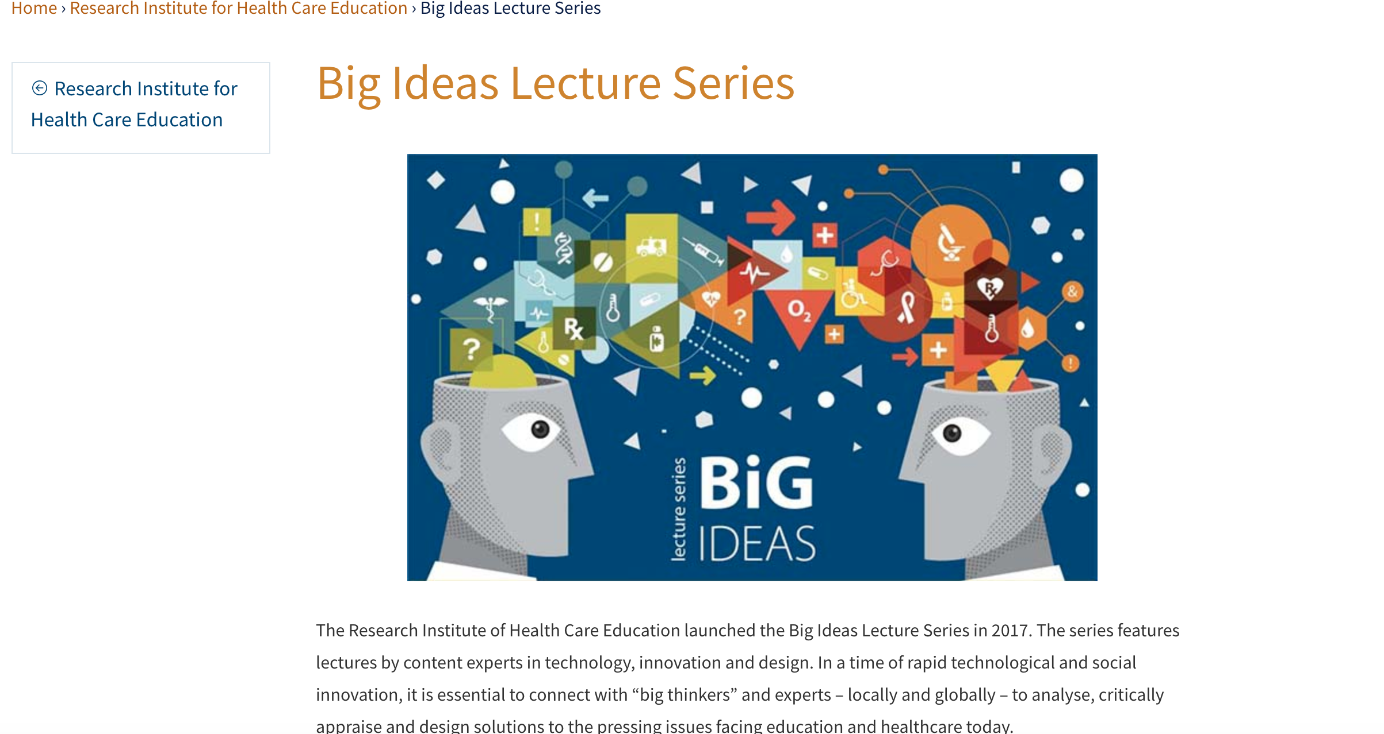
CAPACITY BUILDING
Notes:
One capacity building activity that has been very well received over the past year has been our Big Ideas Lecture Series.
These lectures happen every 2 to 3 months and are hosted in our auditorium and also web cast and archived.
The purpose of this series is to invite speakers to provoke new ideas in the health and education sectors.
Examples of speakers include:
Dr. Ann Cavoukian, speaking to the issue of Privacy in the Era of Big Data
Dr. Ann Heesters, speaking to the issue of medical assistance in dying and MAID legislation from an ethical patient-centred care perspective
Dr. Peter Pisters, speaking to the impact of Blockchain on health care delivery and care
Dr. Brian Hodges, speaking to the impact of AI on the future of the professions, especially as it relates to compassionate patient-centred care
Dr. Nikki Words, speaking to the importance of scientific knowledge and the development of expertise
We have had 9 speakers in total over the past 18 months and we welcome participation from the college sector. This forum allows us to build community and collectively tackle pressing issues of importance to the future of health care and education.

Slide 15

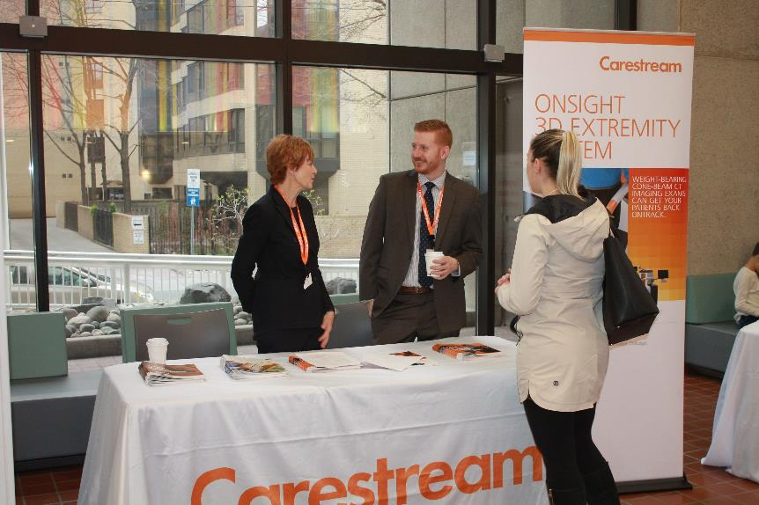
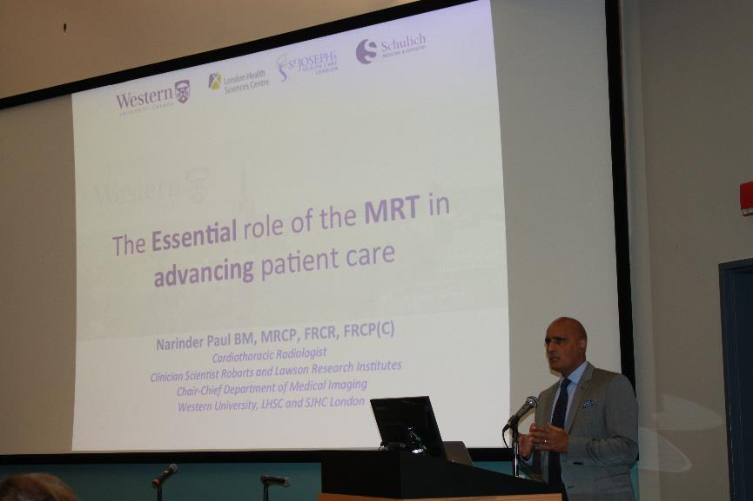
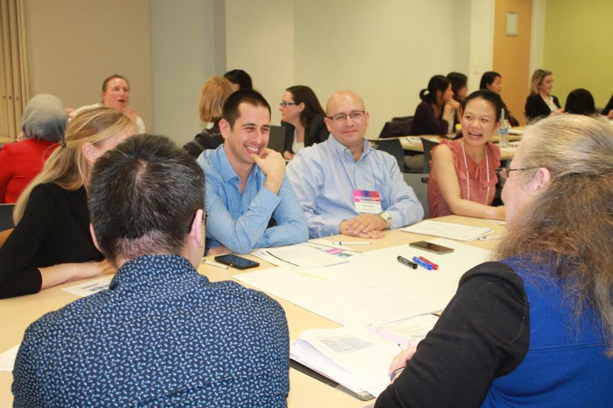
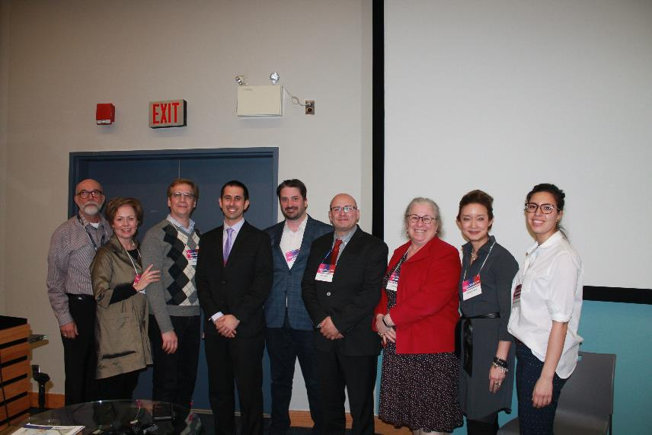
Notes:
Story – C ultivating Academic Pracrtice Acros Professions
Collabortion with CAP, Bioethics, Education, Libraries
Wavelengths interprofessional/interdisciplinary; this is the kind of collaboration we envision to build capacity or produce scholarship research across the membership categories and beyond; we expect scientists, scholars, trainees will be learning from participation in RIHCE events and activities as well as leading in their areas of experience and/or expertise.
Submissions -- Approximately 50 submissions
21 poster presentations
30 Oral presentations including keynotes (Saturday)
16 oral presentations from JDMI
Registrants -- Over 100 registrants for the symposium and about 50 for the pre-symposium research workshop / speaks to the interest in quality improvement and research in the applied health sciences; two potential partnerships for the RIHCE with London Health Sciences
Feedback -- 50% of participants for the research workshop completed evaluations; 100% agreed or strongly agreed that 1) the presentations added to their learning, 2) the small group sessions helped them gain insight into the QI and research process, and 3) that the facilitators enhanced their learning in the small group sessions.
Specific Examples
Prepping for Success: Improving the communication of patient preparatory instructions for CT colonography
Sex, Identity, Gender, Expression form- Pilot Project
Establishing guidelines for quality assurance and clinical application of metal artifact reduction (O-MAR) software in Radiation Therapy
Patient as observer; Practical steps to launching a hand hygiene quality assurance program in the medical imaging outpatient setting

Slide 16
Thank You.

