Slide 1
What does is mean to “decolonize” Allied Health curricula?
Charlotte Loppie
Centre for Indigenous Research and Community-Led Engagement
University of Victoria
http://www.latordera.it/wp-content/uploads/naturale-equilibrio4.jpg

Slide 2
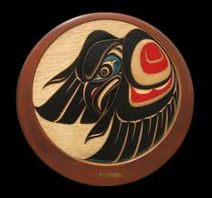
Honoring the lekwungen - and Sencoten-speaking peoples
http://northwestcoastdesigns.com/wood6.htm

Slide 3
Pathways to Knowing
Indigenous
Western
Knowledge and Skills
Relationships
Experiential Learning
Pragmatism/Subjectivism
Curriculum
Learning Environments
Knowledge Systems
Worldview
Knowledge and Skills
Schools, universities
Scientific Discovery
Post-Positivism/Critical Realism

Slide 4
What is a worldview?
A specific way of seeing the world – a framework comparable to a paradigm – but much broader and deeper.
It is an invisible lens through which we unconsciously (or consciously) translate experiences.
Truth is a core concept in worldviews.
Pluralism- Multiple truths can exist
Single truth - if one thing is true, its ‘opposite’ cannot also be true.
http://www.tapestryinstitute.org/worldview.html
Notes:
A paradigm is a framework containing the basic assumptions, ways of thinking, and methodology that are commonly accepted by members of a scientific community.
It affects peoples universally through culture
It affect assumptions about reality

Slide 5
Indigenous Worldviews
A universal Indigenous worldview does not exist.
The cultural worldview of Indigenous peoples varies but the core is deeply connected to land and water.
Indigenous cultures are rooted in a specific place but colonization has uprooted many Indigenous peoples from their traditional homelands.
Indigenous cultures are not static, nor have they been lost through assimilation.
Many Indigenous people have adapted to colonial realities while holding to their cultural worldview.

Slide 6
Indigenous worldviews
Indigenous societies have always possessed distinct systems of knowledge, philosophy, medicine and government.
Indigenous worldviews are often reflected in value themes of:
holism - elements of the whole are intimately interconnected, such that they cannot be understood independently, nor without reference to the whole.
relationality – deep connection and responsibility toward family, community, environment and cosmos.
balance and harmony within and between all dimensions of self, wellness, relationships, ecology, etc.
respect for humans and non-humans.

Slide 7
Colonization and the
fallacy of cognito nullius
“knowledge belonging to no one"

Slide 8
Colonizing education…
‘Owns’ knowledge
Controls the process, analysis, interpretation and reporting of knowledge
Determines who has Access to knowledge
Possesses the products of knowledge generation (information)
http://fnigc.ca/ocapr.html

Slide 9
Colonized Education
The development, support and expansion of curriculum that does not acknowledge or value Indigenous knowledge systems, ontologies, methodologies or contributions.
A process whereby scholarly authority and control is claimed by non-Indigenous academics, which creates multiple inequities for Indigenous peoples.

Slide 10
What’s in a name?
Indigenize
Decolonize
To bring under the control, dominance, or influence of the people native to an area.
Requires an Indigenous framework and a centering of Indigenous land, Indigenous sovereignty, and Indigenous ways of thinking.
To withdraw from (a colony), leaving it independent.
To allow a previously colonized people to become self-governing or independent.

Slide 11
Reconcile
Restore friendly relations
Coexist in harmony
https://www.google.ca/webhp?hl=en&#hl=en&q=reconciled

Slide 12
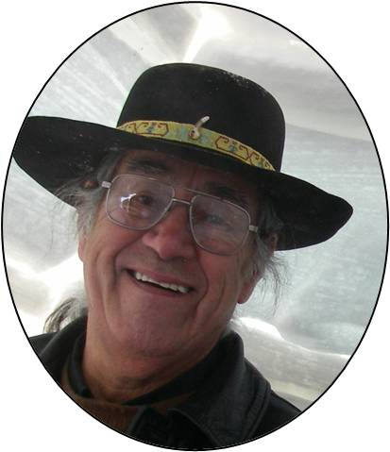
http://www.cihr-irsc.gc.ca/e/43686.html

Slide 13
http://www.ecdip.org/images/gif/ethics-ethicalspace.gif

Slide 14
reconciling Curricula
Reconciling elements essential to the curriculum:
Worldviews
Knowledge systems
Voices
Critiques
Scholars and students

Slide 15
Reconciling Curricula
Balance the dominant narratives about our collective histories, contemporary aspirations and challenges.
Acknowledge colonization in Canada, land use and development, Indigenous sovereignty, residential school histories, Missing & Murdered Indigenous Women.
Employ relevant Truth and Reconciliation Calls to Action

Slide 16
Reconciled Curricula
Avoids conflating Indigenous content with multiculturalism.
Explores diverse Indigenous peoples voices (Inuit, Métis, Bi-racial, LGBT, global and local)
Includes co-teaching courses with Indigenous people from outside the university; consider alumni, local professionals, and Indigenous community members and others.
Includes course delivery and classroom design that encourages dialogue (circle format; small table groupings; and other approaches)

Slide 17
Reconciled Curricula
Utilizes the local protocols
Some courses are required of all learners
Courses take up topics associated with Indigenous-settler relations, treaty responsibilities, and actions aimed at reconciliation.
Courses are designed so that learners gain a deeper understanding of of Indigenous knowledge.
Indigenous learners are not expected to address Indigenous issues.
Course outlines are reviewed for Indigenous content by Indigenous peoples with knowledge and experience.

Slide 18
Reconciled curricula benefit everyone
We view the world more broadly.
We are more balanced in our knowledge and practice.
We enjoy more harmonious relationships
We enhance our collective wellness.

